Slide 1


2024
Aura Playbook
Workforce Analytics & Insights

Slide 2

AURA PLAYBOOK
Agenda
Introduction to Aura
Due Diligence: Key use cases & sample outputs
General Consulting: Key use cases & sample outputs
How to get started now
FAQs and additional information

Slide 3
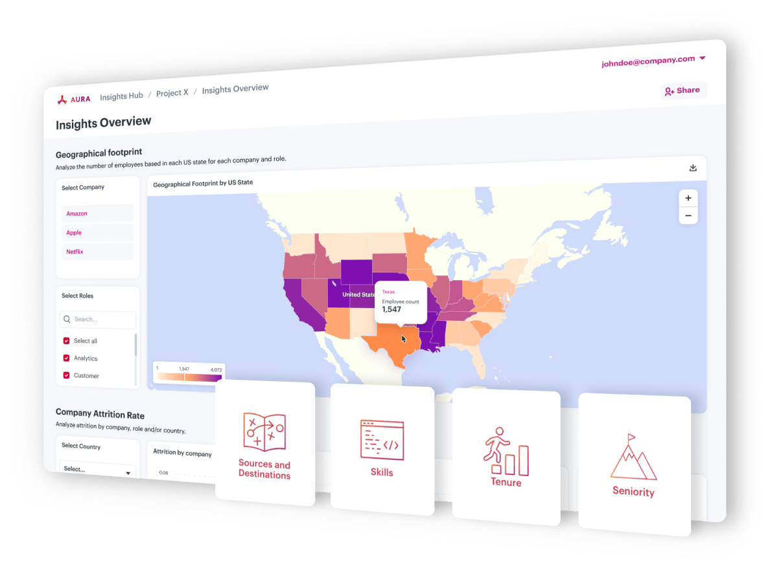



AURA PLAYBOOK
Aura is the premier SaaS workforce analytics and insights platform
Unlock the power of workforce intelligence
Aura is a workforce insights & analytics platform
that provides the latest workforce intelligence to enable data-driven recommendations to clients
in an efficient and cost-effective manner
Only recently has this powerful outside-in data become available and through Aura teams can uncover new insights that were previously unattainable
Insights can be used to enhance client proposals, due diligences and consulting projects, enabling teams to unlock revenue growth, reduce costs
and minimize talent-related risks

Slide 4


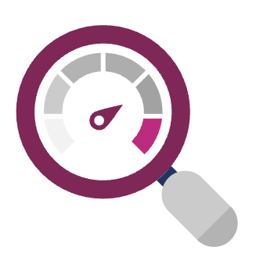

AURA PLAYBOOK
Leverage Aura to gain high-quality insights, increase productivity and cut costs
Empowering you to win business
Reducing costs
Increasing Speed to Delivery
Improving Analysis Quality
Win new business by leveraging outside-in analyses to demonstrate your firm’s ability to provide strategic insights
Replace costly, manual web-scraping with unlimited access to billions of data points and save up to 60% of costs
Empower your consulting teams to perform detailed analyses in minutes that previously took days
to complete
Access highly granular, comprehensive data refreshed on a sub-monthly basis, while reducing the risk of human errors
“Aura is a huge differentiator for us, especially in pitches”
- Manager, Bain
“A manual data scrape would have cost us more than Aura”
- Senior Manager, Bain
“Aura cut our working time
in half, which is fantastic”
- Consultant, Bain
“Aura allows us to create insights that we have not seen before”
- Partner, Mercer

Slide 5

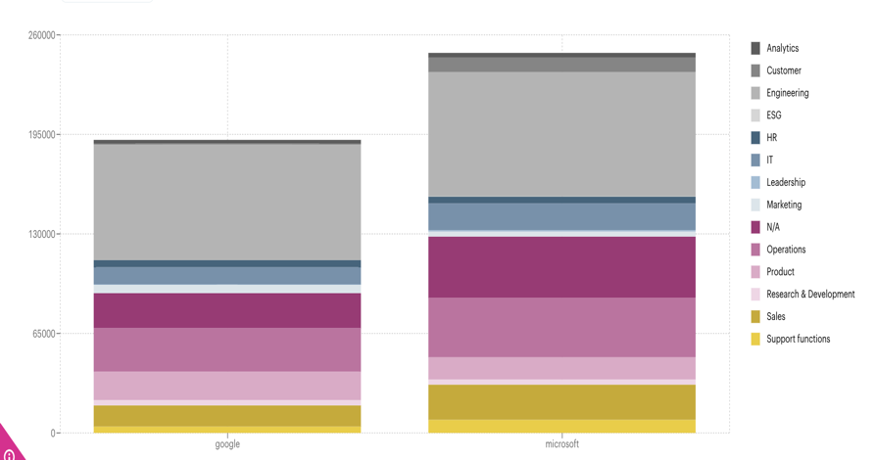
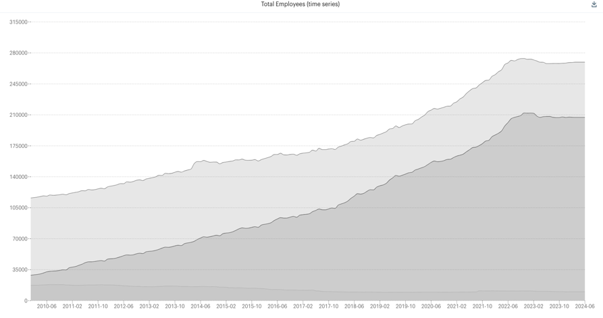
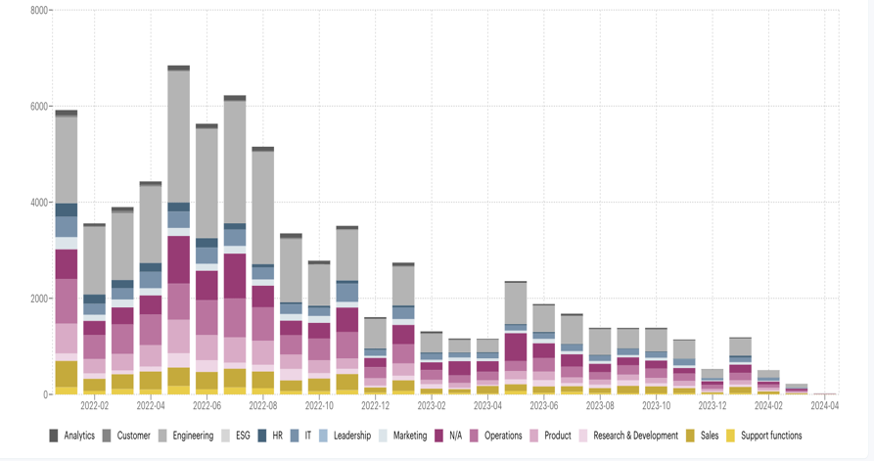
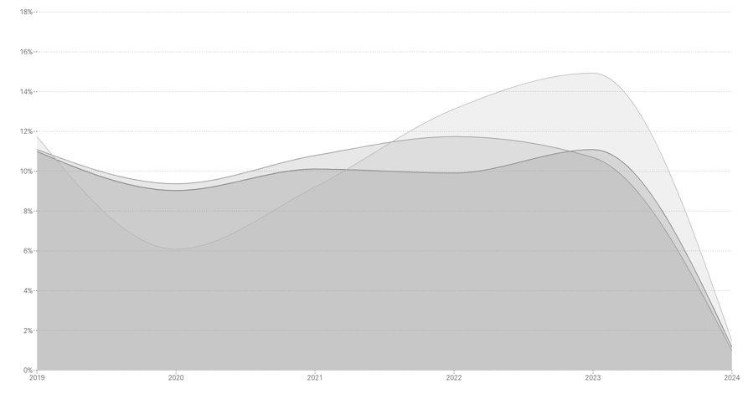
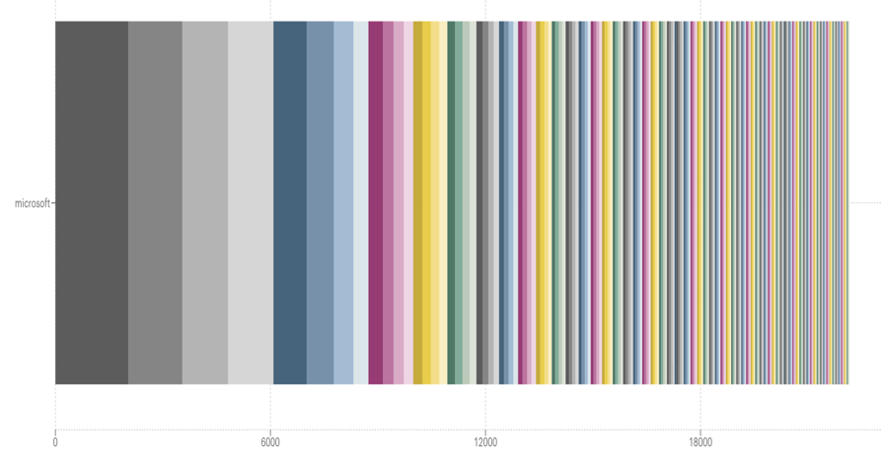
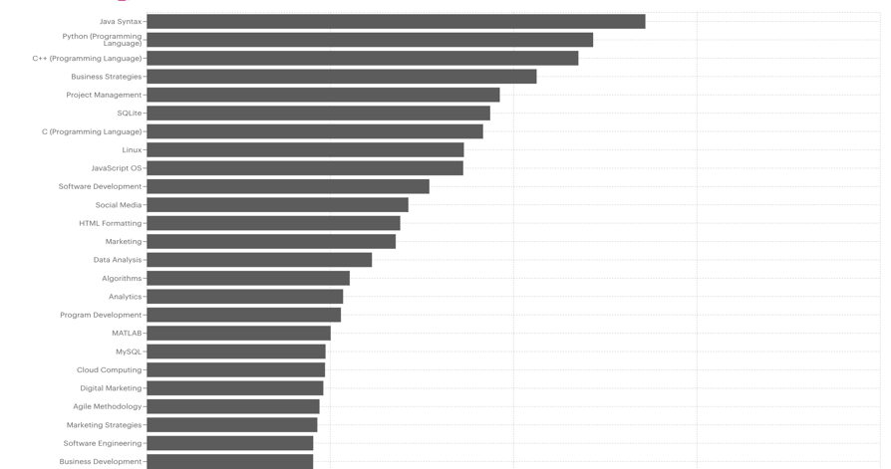
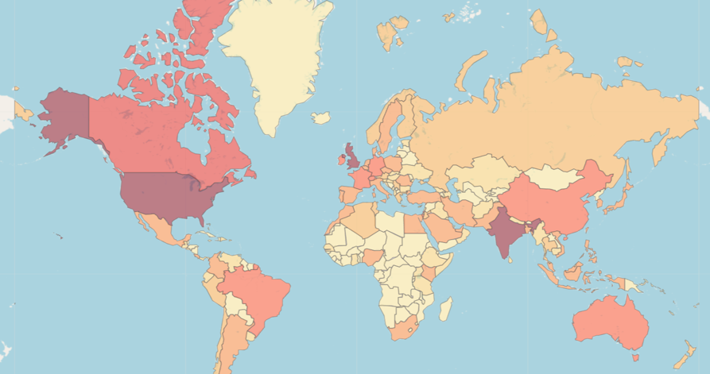
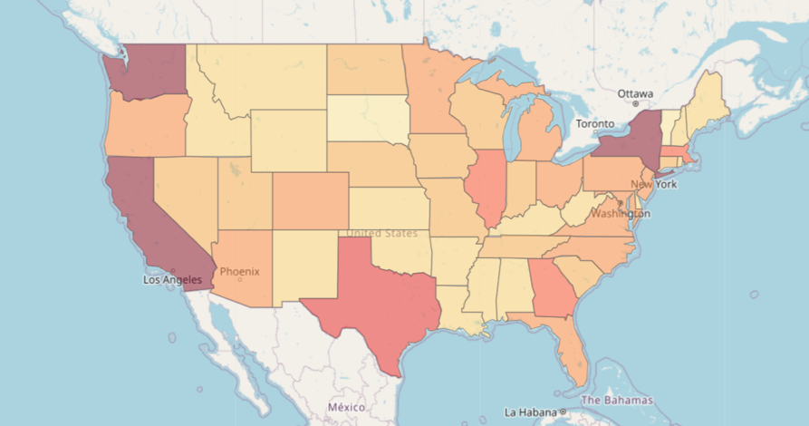
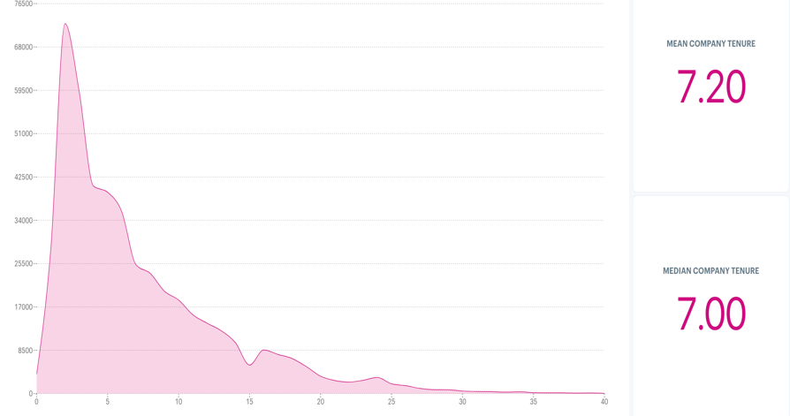
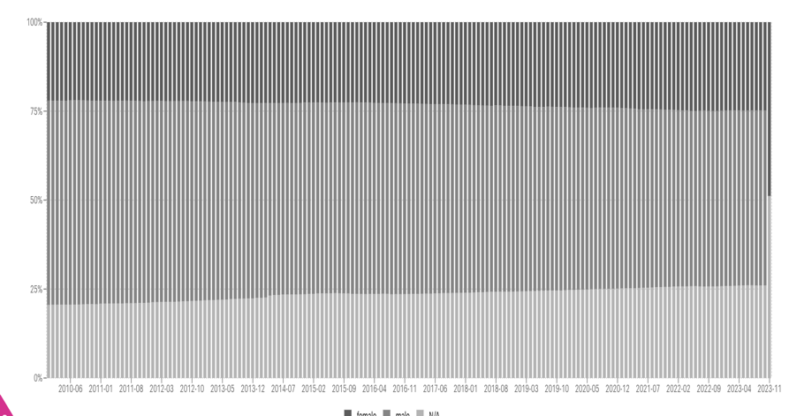
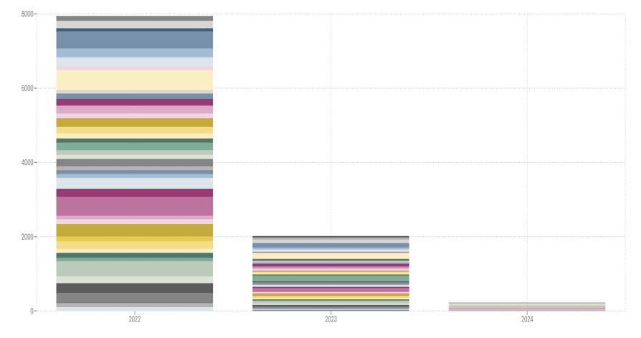
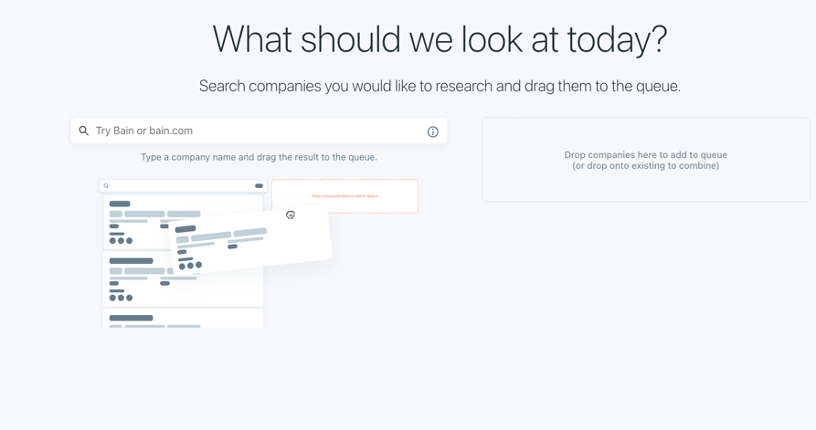
AURA PLAYBOOK
Access a variety of ready-to-use dashboards that are constantly growing
Role ratios & headcount
Headcount growth
Hiring
Attrition
  Export any data down to the employee level
Sources & destin. of talent
Skills & certifications
Geo footprint – Global
Geo footprint – US
Tenure
Gender over time
Top schools
… and much more!

Slide 6





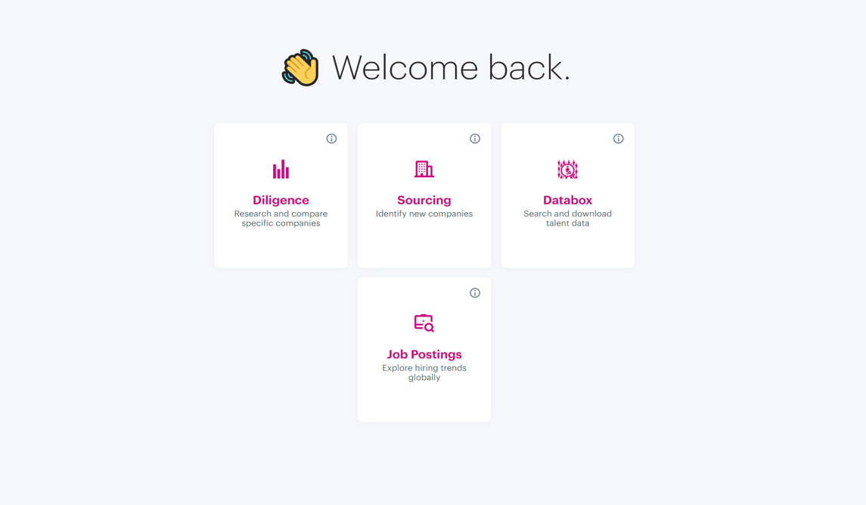
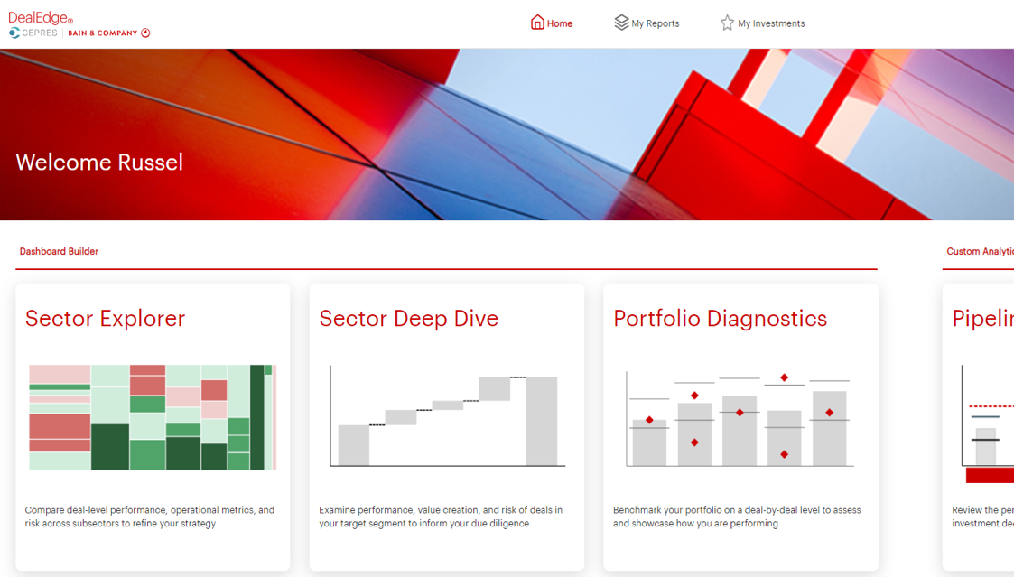
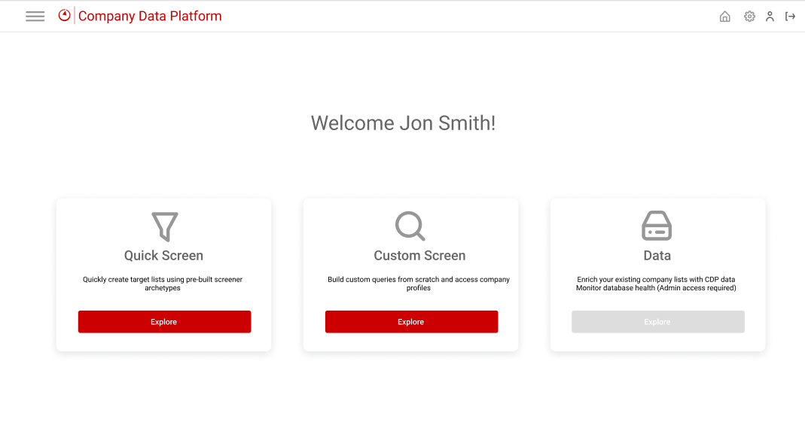

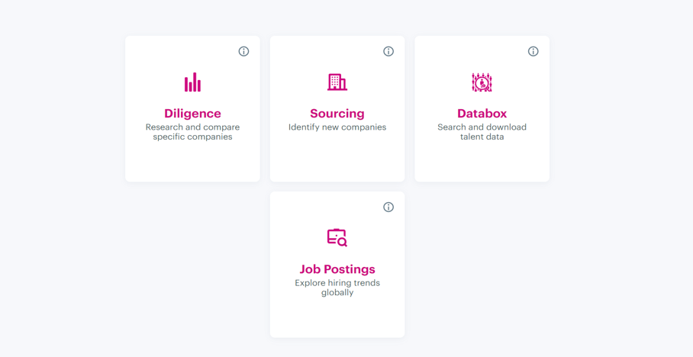





AURA PLAYBOOK
Aura harnesses data from a diverse range of public and private sources
Job Boards
500M+
Job
postings
1B+
Employee
profiles
20M
Company profiles
… and more
Social Platforms
… and more
Company Data
… and more
Automated Data Collection
Ingestion, Processing & Analysis
Client Dashboards & Insights
Aura collects data points from a variety
of public and private sources which
are continuously being updated
Proprietary data analytics models leveraging Al and ML are overlayed to synthesize and produce meaningful workforce insights
Aura's portal provides access to interactive dashboards and reports, helping our clients make more informed, data-driven decisions

Slide 7









AURA PLAYBOOK
Aura drives value with proven success across a variety of use cases
Aura is leveraged across MC and PE firms with success
Strategic Capabilities
Commercial Excellence
Ad-hoc Business Strategy Issues
Performance Improvement
Cost Transformation
Private Equity
Other Functions
Commercial Due Diligence
Market Opportunity & Segmentation
Organizational & Op Model Transformation
IP Development
Mergers & Acquisition
Business Intelligence
Portfolio Optimization
Internal data providers
Aura clients (not exhaustive)

Slide 8
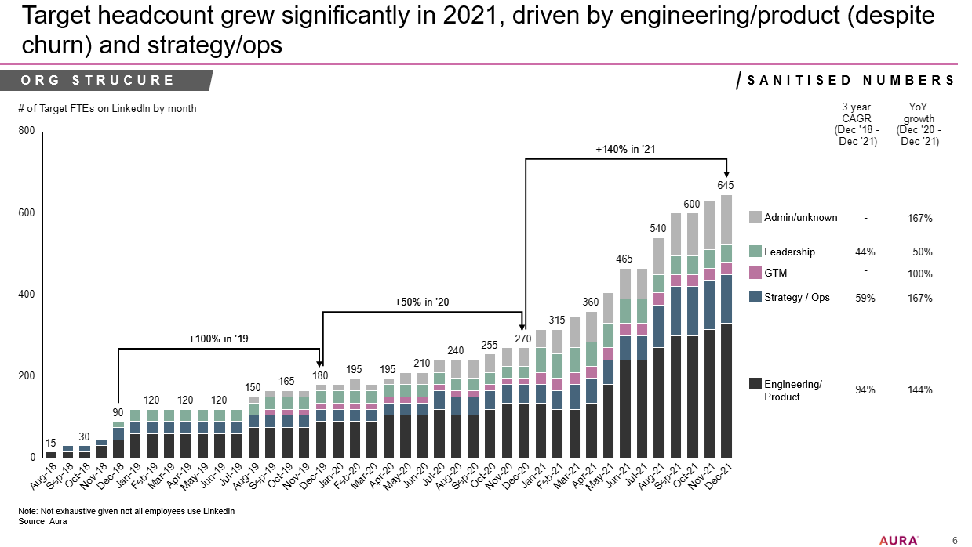
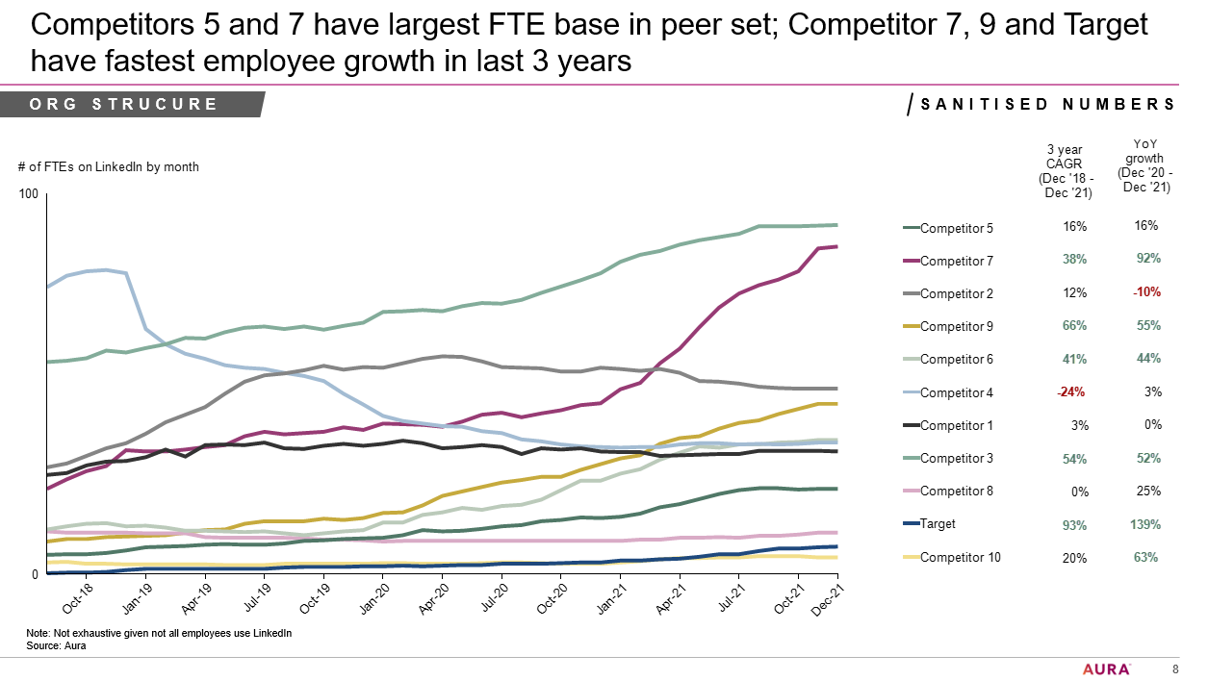
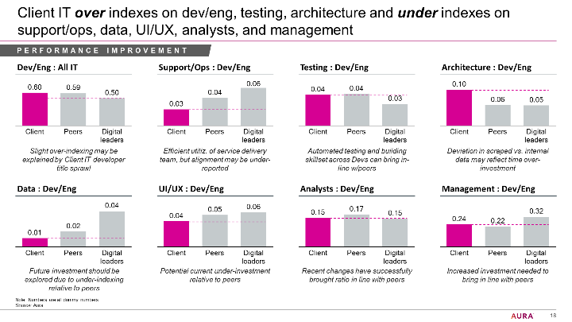
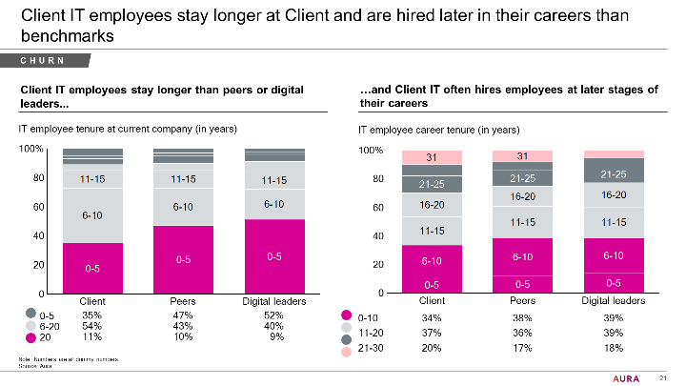
AURA PLAYBOOK
Over 1,300 consultants have already used Aura, delivering results for 500+ clients
Due Diligence
Case example: Commercial DD in the technology sector
Key questions: How has the target been growing versus peers? Which functions have been driving growth?
User feedback: “Aura is a great tool to extract workforce data and private equity clients love the analyses”
General Consulting
Case example: Performance improvement for an airline
Key questions: Is the client’s IT department rightsized? Are there opportunities to save costs?
User feedback: “Aura was very easy to use and had all the granular data we needed on FTE sizes and splits”
Proprietary Articles
Article example: Choosing the right CIO
Key questions: What are typical backgrounds of CIOs? Are CIOs usually promoted internally or hired externally?
User feedback: “We only had a week for the article and Aura allowed us to quickly gather the relevant insights”

Slide 9
AURA PLAYBOOK
Agenda
Introduction to Aura
Due Diligence: Key use cases & sample outputs
General Consulting: Key use cases & sample outputs
How to get started now
FAQs and additional information

Slide 10
AURA PLAYBOOK
Due Diligence: Key use cases and questions Aura can address
NOT EXHAUSTIVE
Market Dynamics
  How much has the market grown in headcount, and how does the target’s growth stack up?
  What are the market size shares in terms of headcount among key players?
1
  How strong is the workforce within the target’s core business activities/capabilities?
  What is the experience level (i.e., career tenure) of the target’s talent base?
  What are the educational backgrounds of the target’s talent base?
  How well-equipped is the target around Data & AI to leverage the full potential of GenAI?
Competitive Strength
2
  Does the target have overstaffed departments relative to its peers (esp. non-core functions)?
  Is the management/leadership size of the target firm overweight compared to industry norms?
  Are there opportunities to offshore staff in high-cost countries to more cost-effective locations?
  To what extent can GenAI drive productivity gains to save costs across functions?
Operational Efficiency
3
  How effective is the sales team of the target in terms of revenue per sales FTE?
  What is the scale of the salesforce at the target firm, and is it adequately sized to capture growth?
  Does the target have the right mix of salespeople (i.e., account managers, technical sales, field sales, etc.)?
  How is the salesforce geographically distributed and how might this relate to market penetration?
Go-To-Market Capability
4
  Where does the target firm source talent from and can it prevail over its competitors?
  Does the company meet its employees' expectations and retain its key talent?
  Has key/ senior talent recently been poached by or moved to major competitors?
  What is the overall employee sentiment (i.e., job satisfaction) of the target versus its peers?
Talent Attraction & Retention
5

Slide 11
AURA PLAYBOOK
1) Due Diligence | Market Dynamics
  How much has the market grown in headcount, and
  how does the target’s growth stack up?
  What are the market size shares in terms of headcount
  among key players in the target’s industry?
Evaluate the market's growth rates and compare it with the target’s growth rate to gauge market attractiveness and the target’s competitiveness
Break down the market’s total headcounts by key players to estimate
the market shares of the target company and its main competitors

Slide 12
AURA PLAYBOOK
2) Due Diligence | Competitive Strength
  How strong is the workforce within the
  target’s core business activities/ capabilities?
  What is the experience level (i.e., career tenure)
  of the target’s talent base?
Understand potential competitive edge of target firm by mapping out employee count and ratios in most critical departments versus industry peers
Assess avg. career tenures across the target and for key functions to better understand expertise and skill levels
  What are the educational backgrounds of
  the target’s talent base?
  How well-equipped is the target around Data
  & AI to leverage the full potential of GenAI?
Leverage Aura to assess education levels (e.g., share of PhDs) as an indicator of high proficiency
Analyze the target’s share of FTE related to AI & Data Mgmt. to infer GenAI readiness/ leadership among competitors

Slide 13
AURA PLAYBOOK
3) Due Diligence | Operational Efficiency
  Does the target have overstaffed departments relative to its peers (esp. non-core functions)?
  Is the management/ leadership size of the target firm overweight compared to industry norms?
Benchmark the size and efficiency of non-critical functions (i.e., HR, Legal, Finance) to identify cost improvement levers
Check the differences in management layers between target and peers to understand potential inefficiencies in its structure
  Are there opportunities to offshore staff in high-cost countries to more cost-effective locations?
  To what extent can GenAI drive productivity
  gains to save costs across functions?
Understand the target’s geographical structure and opportunities to realize cost savings by relocating its workforce to low-cost countries
Evaluate the target’s automation potential of its functions and tasks through GenAI and the resulting financial benefits

Slide 14
AURA PLAYBOOK
4) Due Diligence | Go-To-Market Capability
  How effective is the sales team of the target in terms of revenue per sales FTE?
  What is the scale of the salesforce at the target, and is it adequately sized to capture growth?
Determine productivity levels of the target’s sales team compared to its direct competitors and industry standards
Assess the size of the target’s salesforce versus its peers to better understand its
go-to-market readiness
  Does the target have the right mix of salespeople (i.e., account mgrs., tech sales, field sales, etc.)?
  How is the salesforce geographically distributed and how might this affect market penetration?
Review the target’s sales function set-up against its competitors to gauge the capabilities of its sales teams
Identify well-covered areas and white spots spots in the geographical distribution of the target’s salesforce

Slide 15
AURA PLAYBOOK
5) Due Diligence | Talent Attraction & Retention
  Where does the target firm source talent from
  and can it prevail over its competitors?
  Does the company meet its employees' expectations and retain its key talent?
Examine the target’s talent sources and flows between keys competitors
Analyze attrition and churn rates of the target’s employee base versus industry standards
  Has key talent recently been poached by
  or moved to major competitors?
  What is the overall employee sentiment of
  the target versus its peers?
Check employee exits and top destinations to detect potential trends in talent movements
Compare employee satisfaction and its drivers among the target and peers to assess potential talent risks

Slide 16
AURA PLAYBOOK
Agenda
Introduction to Aura
Due Diligence: Key use cases & sample outputs
General Consulting: Key use cases & sample outputs
How to get started now
FAQs and additional information

Slide 17
AURA PLAYBOOK
General Consulting: Key use cases and questions Aura can address
NOT EXHAUSTIVE
  How does the client’s headcount per revenue/ volume compare with peers, across the full org and by function?
  Is the distribution of headcount across functions aligned with industry standards or are some functions overweight?
  Does the client have a disproportionately high number of senior management roles compared to industry norms?
  What is the proportion of offshored employees in low-cost countries (e.g., in G&A) versus competitors?
Cost Optimization
1
  How are competitors structuring their organization in terms of function sizes and role distributions?
  How are peers organized geographically and what are their prioritized regions?
  What are the typical management structures and spans of control among industry peers?
  To what extent are different functions centralized versus decentralized in the client’s industry?
Operating Model
2
  What talent has the client invested in and where does it have gaps (e.g., Salesforce, AI & Data capabilities)?
  Does the client have the right mix of talent within its key capabilities to drive growth?
  Does the client have the required levels of experience and education in its workforce?
  How do the skills reported by employees compare with those of key competitors?
Capability Assessment
3
e.g., Commercial Excellence, Digital
  How do the client’s retention and attrition rates measure up against industry benchmarks?
  Where can the client source required capabilities, and which talent pools are their peers tapping into?
  Which companies do we compete with most for top talent, and are they actively hiring from the client?
  How satisfied are the client’s employees with their job and what are the key drivers?
Talent Strategy
4

Slide 18
AURA PLAYBOOK
1) General Consulting | Cost Optimization
  How does the client’s headcount per revenue / volume compare with peers?
  Is the distribution of headcount across
  functions aligned with industry standards?
Benchmark the client’s overall workforce and function sizes with key competitors to identify cost reduction potential
Compare the client’s headcount distribution with its peers to detect potential overweight functions
  Does the client have a disproportionately
  high number of senior management roles?
  What is the proportion of offshored employees
  in low-cost countries?
Assess how the size of the client’s management layers measures up against industry norms and best practices
Evaluate cost saving opportunities by relocating employees from high-cost countries to more cost-effective locations

Slide 19
AURA PLAYBOOK
2) General Consulting | Operating Model
  How are competitors structuring their organization in terms of function sizes and role distributions?
  How are peers organized geographically and
  what are their prioritized regions?
Compare the structure and role proportions of the client’s functions to its peers and industry standards
Review how the client’s geographical footprint and structure measures up against its key competitors
  What are the typical management structures
  and spans of control among industry peers?
  To what extent are different functions centralized versus decentralized in the client’s industry?
Analyze the ratios between client’s teams and seniority layers and benchmark them against comparable firms
Examine which type of organizational model the client’s key competitors apply for different functions

Slide 20
AURA PLAYBOOK
3) General Consulting | Capability Assessment
  What talent has the client invested in and
  where does it have gaps?
  Does the client have the right mix of talent
  within its key capabilities to drive growth?
Evaluate how the size and strength of critical capabilities compares to competitors and industry standards
Understand the talent competitors and best-in-class examples are investing in to develop emerging critical capabilities
  Does the client have the required levels of experience and education in its workforce?
  How do the skills reported by employees
  compare with those of key competitors?
Assess whether the client possesses the expertise necessary to reach their growth targets
Benchmark the skills cited by the client’s employees against key competitors to identify potential gaps

Slide 21
AURA PLAYBOOK
4) General Consulting | Talent Strategy
  How do the client’s retention and attrition rates measure up against industry benchmarks?
  Where can the client source required capabilities, and which talent pools are peers tapping into?
Compare the client’s attrition and churn rate against peers to infer organizational health
Understand from which companies the target and industry peers' source their key talent across functions
  Which companies do we compete with most for top talent, and are they actively hiring from the client?
  How satisfied are the client’s employees with
  their job and what are the key drivers?
Analyze talent flows between competitors to detect relevant emerging trends
Compare employee sentiment of the client with its key peers and identify potential improvement levers

Slide 22
AURA PLAYBOOK
Agenda
Introduction to Aura
Due Diligence: Key use cases & sample outputs
General Consulting: Key use cases & sample outputs
How to get started now
FAQs and additional information

Slide 23
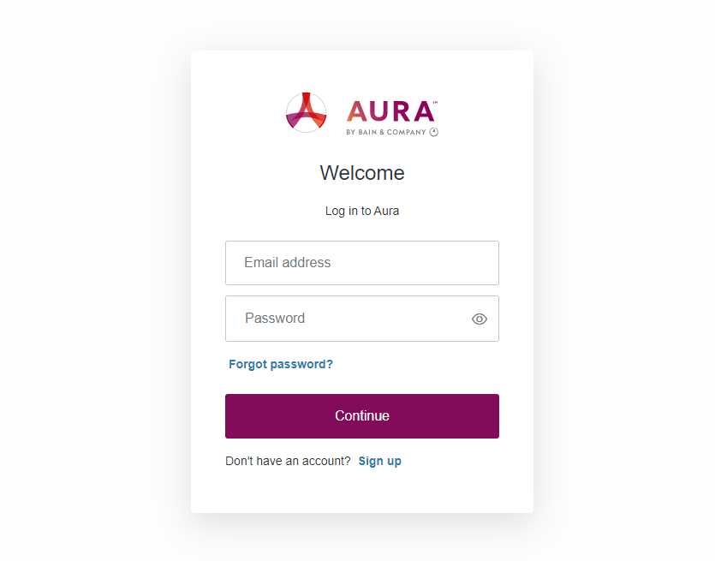
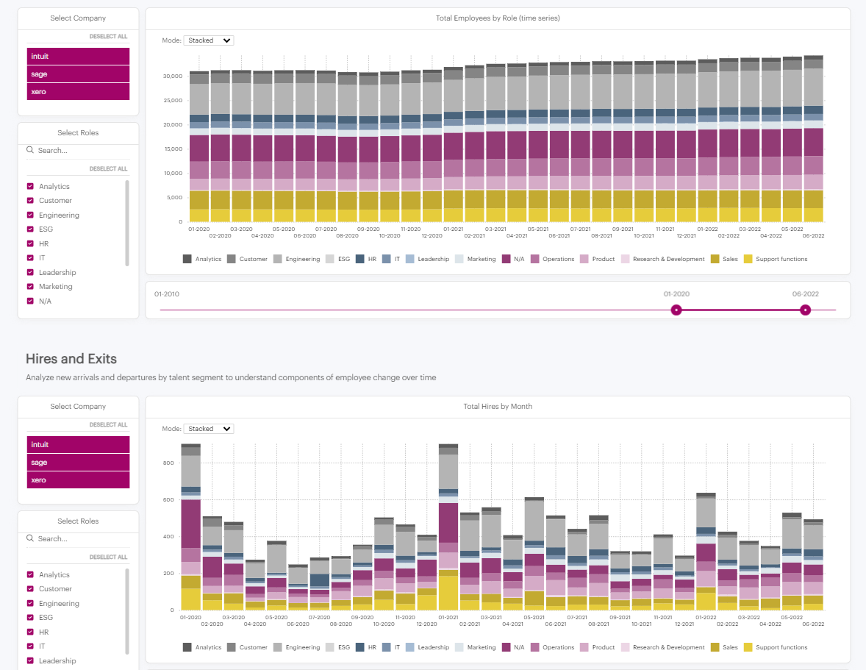
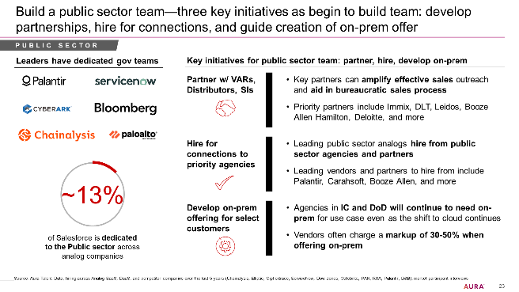
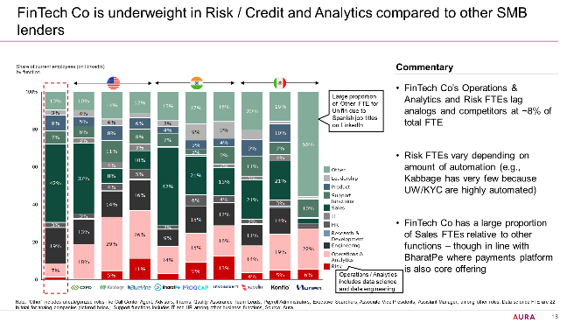
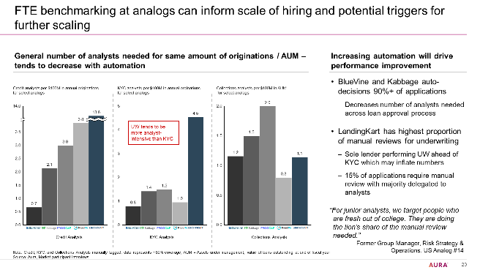
AURA PLAYBOOK
Sign up now and explore the capabilities of Aura
Get access
Scan the data
Build slides
Access Aura at app.getaura.ai
Sign up for a new account on the platform with your company email
Choose a list of companies to analyze
Explore ready-to-use charts for insights across a range of workforce topics
Download the full dataset or select the most relevant dashboards
Build tailor-made slides and wow clients

Slide 24
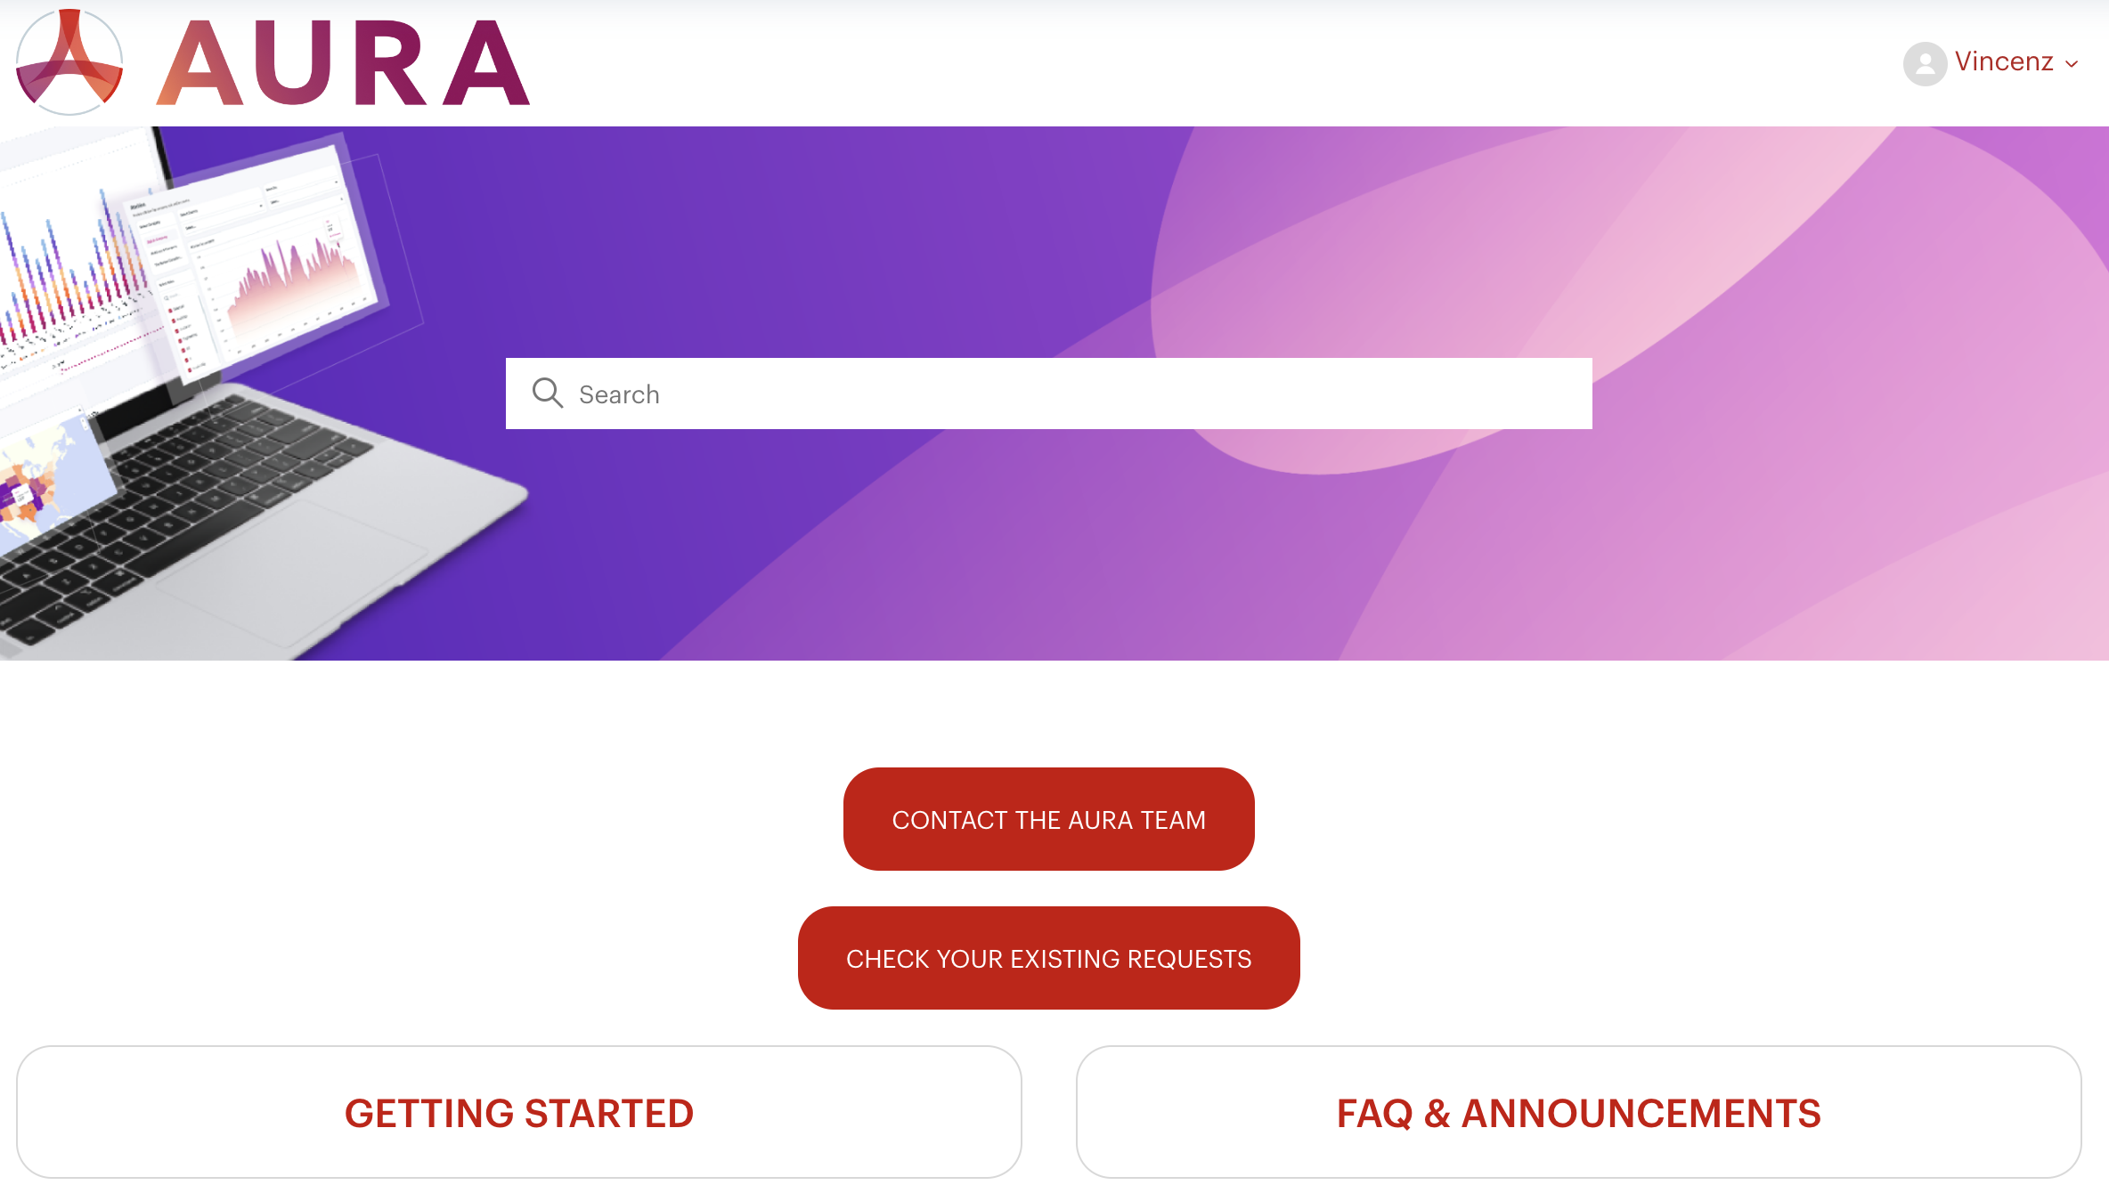
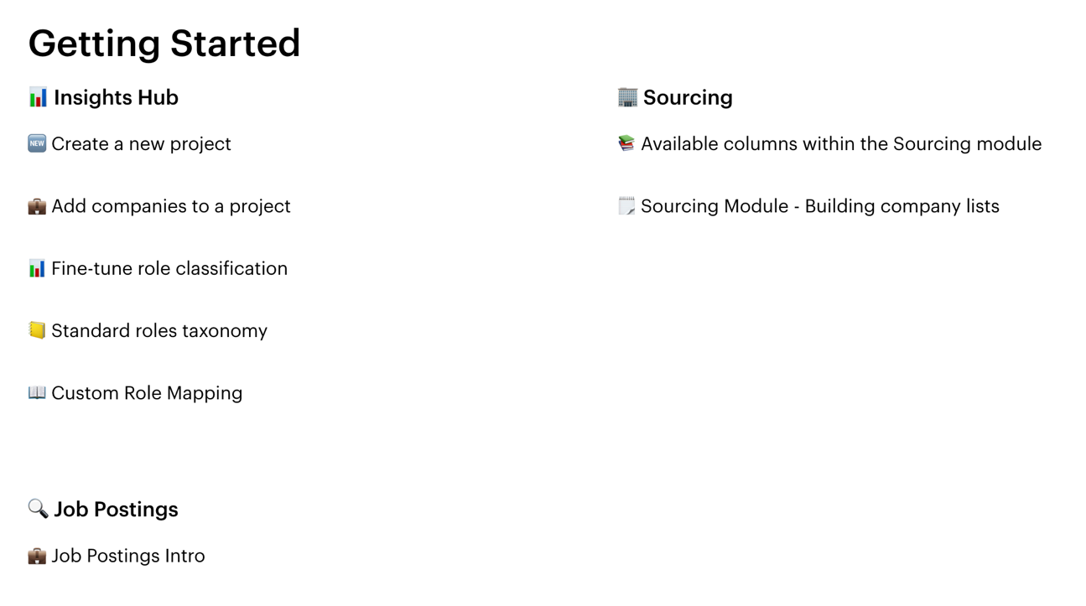

AURA PLAYBOOK
Check out our Help Center for step-by-step instructions of our modules

Slide 25



AURA PLAYBOOK
Our support team is here with replies in minutes
Timo Ussher
Matias Novillo
Dishanth U.
Team Lead, Americas
Team Lead, EMEA
Team Lead, APAC
Please contact support@auraintel.com for any inquiries

Slide 26
AURA PLAYBOOK
Agenda
Introduction to Aura
Due Diligence: Key use cases & sample outputs
General Consulting: Key use cases & sample outputs
How to get started now
FAQs and additional information

Slide 27
AURA PLAYBOOK
Frequently Asked Questions (1/2)
Where does Aura get the data?
We assimilate and normalize data from a range of public and proprietary sources to develop a complete picture of the workforce. This includes (i) public records available from federal, state, local, or foreign governments; open datasets with open data licenses; and information made manifestly public by the consumer or from widely distributed media (ii) online professional profiles, giving us a comprehensive history of an individual including their work history, educational background and skills (iii) job advertisements, detailing the date posted, job description, and skills required (iv) notifications of staff reductions, derived from official public submissions and layoff tracking systems.
How many companies does Aura cover?
Our data covers more than 20 million companies which includes public and private companies worldwide when taking account of subsidiaries and holding companies.
How often the data is updated?
We have some data which are updated daily and weekly such as job postings data, sentiment data, hiring and exits data. Other data is aggregated level are updated monthly.
How does Aura deliver the data?
We deliver data in two ways: (i) Our self-serve platform, where you can access dynamic dashboards (ii) Data feed via snowflake share.
What type of clients does Aura work with?
Our customers and use cases vary considerably. Our biggest customer segments include Hedge funds, Private equity firms, Management consulting firms, financial services, HR organizations, Staffing firms etc.
In what cases Aura’s workforce headcount differ from a company’s reported counts?
Aura’s headcounts differ from a company’s reported counts in some industries and companies having limited online presence of employee profiles, blue collar workforce for e.g., Manufacturing, Mining, O&G, etc. Anecdotally, we would expect largest discrepancies at companies where there is a high population of employees who are part-time, hold roles at other companies, or are freelance/gig workers.

Slide 28
AURA PLAYBOOK
Frequently Asked Questions (2/2)
How does Aura compensate for profiles not having online profiles?
Aura tries to be as close as possible to public source of data. We don't apply a 'black-box' approach to estimate and compensate for profiles without online presence (we believe that this approach can yield worse estimates).
Typically, Aura’s data has the best coverage in English-speaking regions (US, Western Europe, India, etc.) Finance, Technology, and service focused industries and central functions / white-collar roles.
While coverage in other areas may be lower/not fully comprehensive, it is certainly still usable and relevant to get a good sense of the company – we’ve seen clients in the past using Aura’s functional breakdown as directional guidance and scale up using other publicly available information.
How does Aura consider lags in reporting online profiles?
We don't consider lags in reporting by online profiles. You can consider this as a fundamental data source limitation.
Our data is derived from exact counts of our individual employee profiles which are built from cross-referencing multiple data sources. Our compliant process leads to a higher degree of confidence in many cases, but there are outliers where individual employee profile coverage is either outdated, missing certain employees, or inaccurately including additional employees. It is a top and constant priority to continue to improve our data freshness, coverage, and entity resolution accuracy.

Slide 29
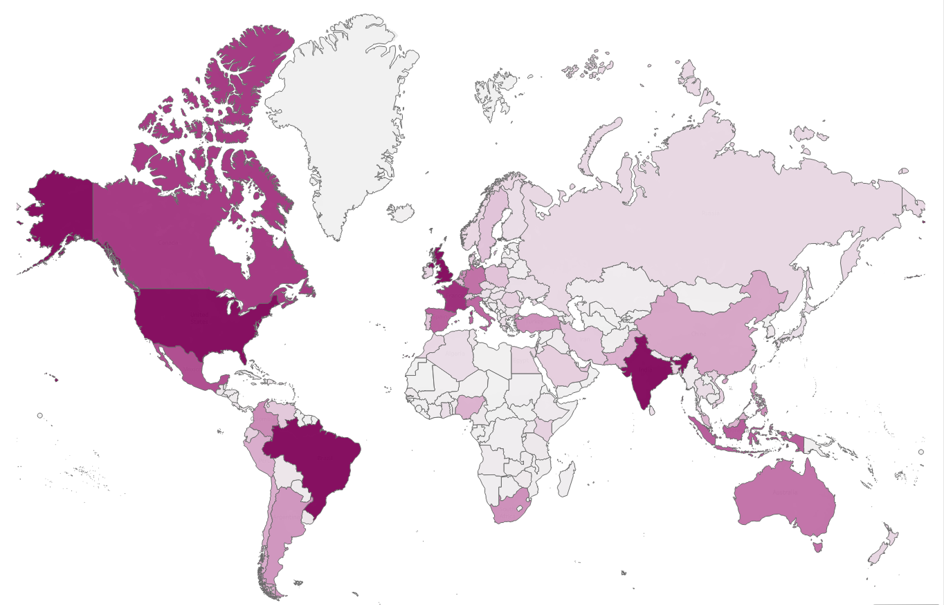
AURA PLAYBOOK
Data Coverage: Employee profiles by country
Germany ~13M
United States
~220M
United Kingdom
~32M
France
~24M
Italy ~15M
India ~71M
Brazil
~56M
Australia ~13M
Note: Excludes profiles without a country information

Slide 30
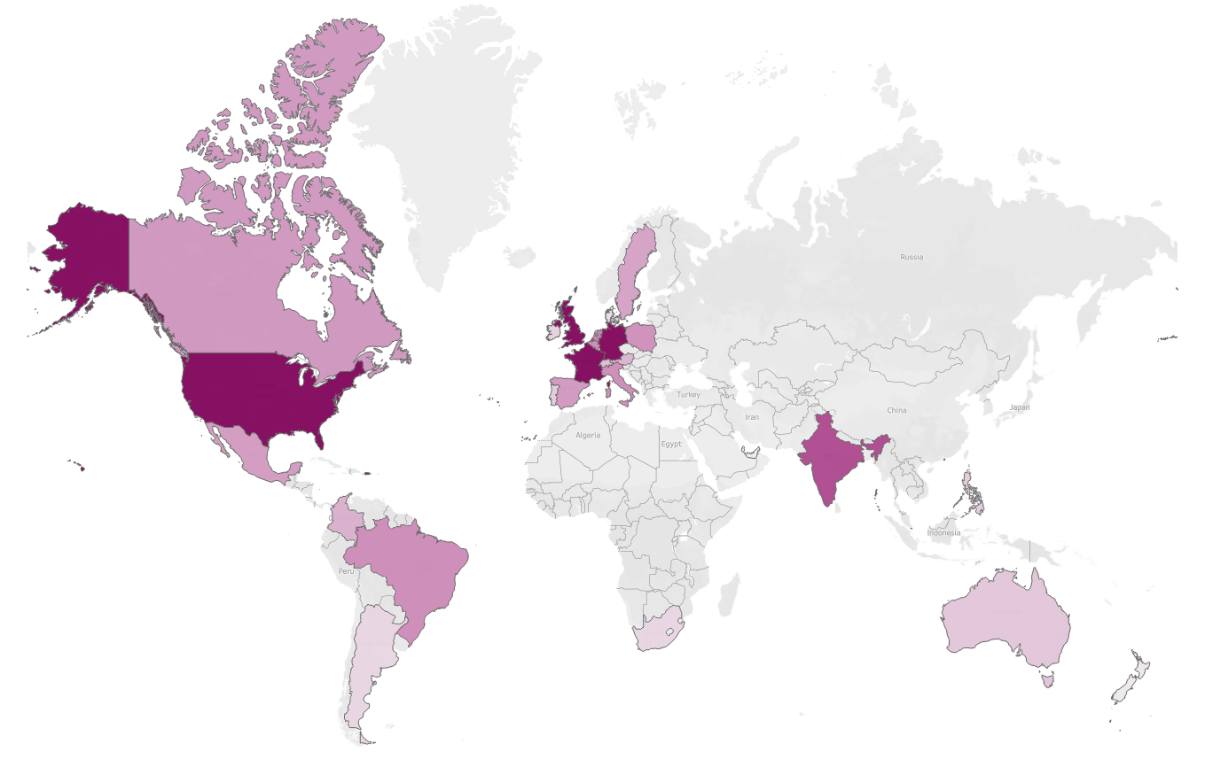
AURA PLAYBOOK
Data Coverage: Job postings by country
Germany ~54M
United States
~196M
United Kingdom
~47M
France
~43M
Italy ~10M
India ~19M
Brazil
~11M
Note: Excludes profiles without a country information

Slide 31
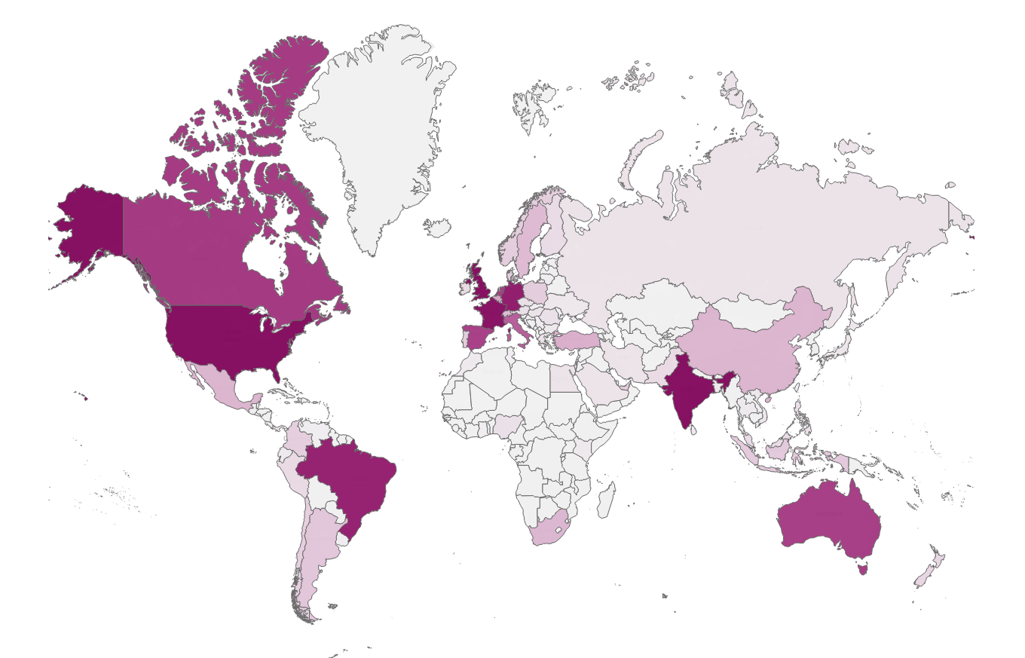
AURA PLAYBOOK
Data Coverage: Companies by headquarter country
United Kingdom
~1.7M
Germany ~0.7M
United States
~5.8M
Canada ~0.53M
France
~1.1M
Italy ~0.42M
India ~1.1M
Brazil
~0.93M
Australia ~0.51M
Note: Excludes profiles without a country information

Slide 32
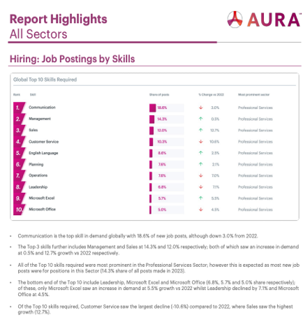
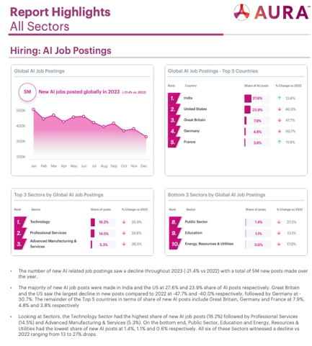
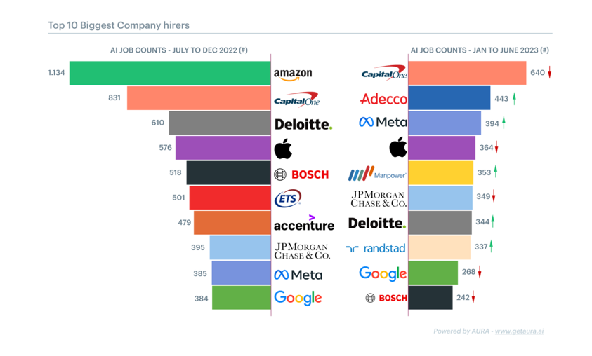
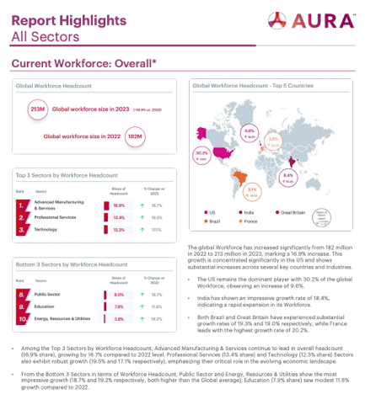
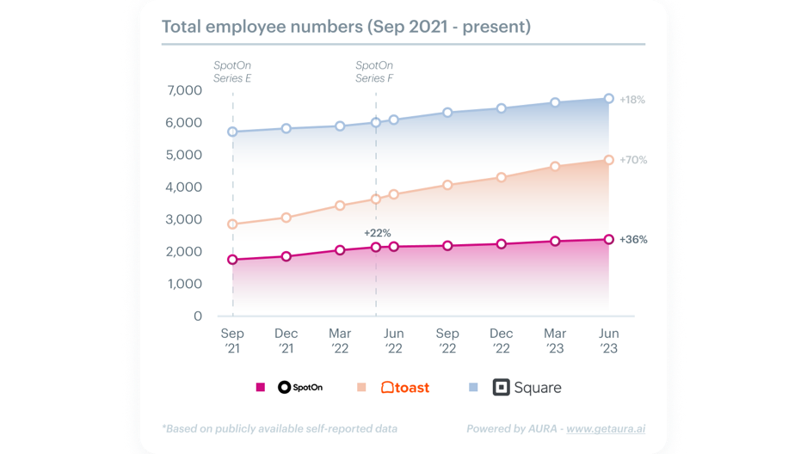
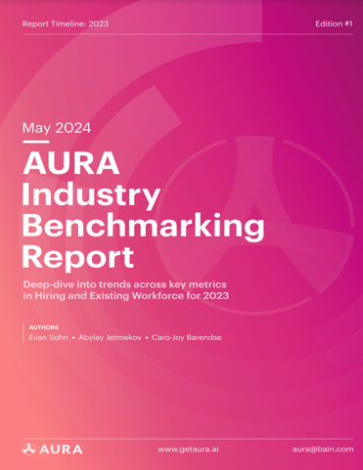
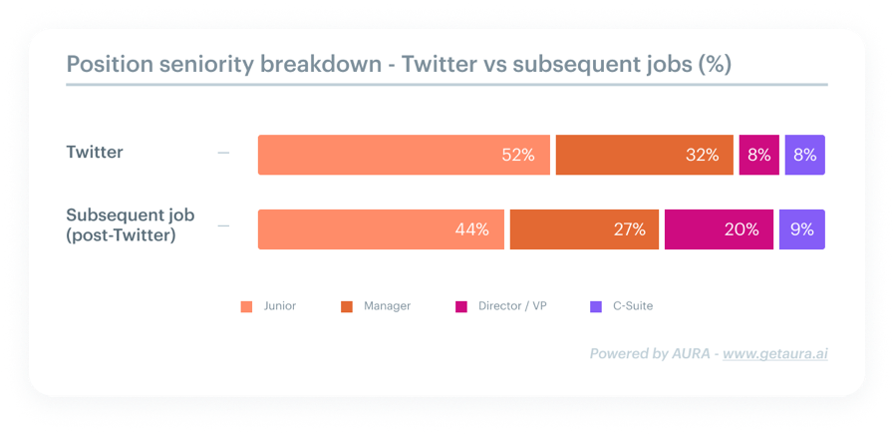
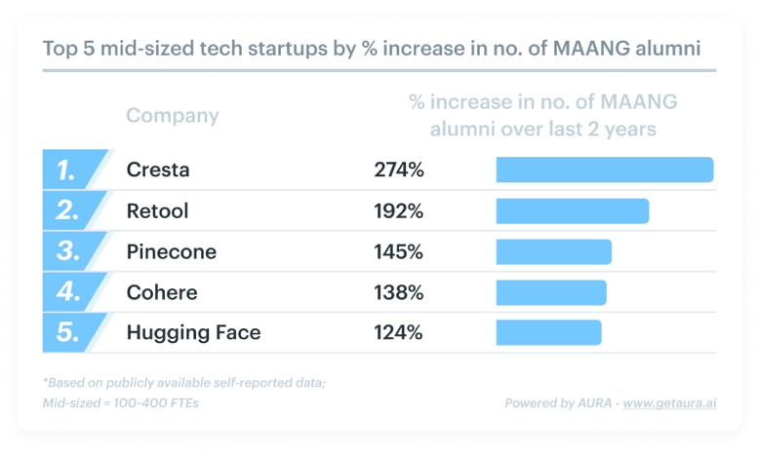
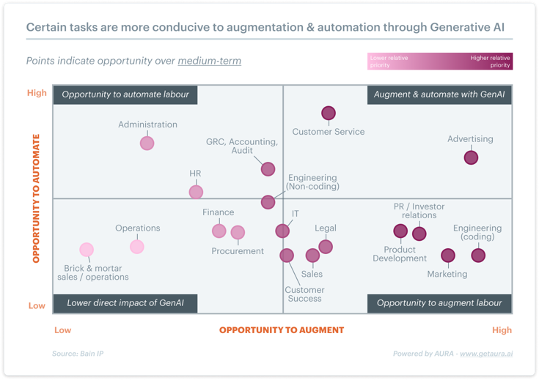
AURA PLAYBOOK
Subscribe now on getaura.ai and view past reports & articles at blog.getaura.ai
1
Industry Benchmarking Report
2
SpotOn vs Competitors:
A Workforce Diligence View
3
ChatGPT Effect: A Data-Driven Dive into AI Hiring
Thought leadership on workforce-related benchmarks across specific industries
Workforce analysis as part of due diligence for potential investors or acquirers,
like PE / VC firms
Recruitment trends – tracking of industry,
company, role, skill trends
4
Twitter Layoffs: Where did they go?
5
MAANG alumni in growing tech start-ups
6
How GenAI will revolutionize the workforce
Layoff cohort analysis to understand top destinations for talent amidst tech layoffs
Alumni cohort analysis to understand which tech start-ups are attracting talent from
Big Tech firms
Thought leadership on the workforce impacts
of the latest technology-driven
innovations & trends

Slide 33
2024

